Slide 1


Slide 2
Python – Normal Distribution
The normal distribution is a form of presenting data by arranging the probability distribution of each value in the data.
Most values remain around the mean value making the arrangement symmetric.
Various functions in the numpy library are used to mathematically calculate the values for a normal distribution.
Histograms are created over which we plot the probability distribution curve.

Slide 3
Python – Normal Distribution
import matplotlib.pyplot as plt
import numpy as np
mu, sigma = 0.5, 0.1
s = np.random.normal(mu, sigma, 1000)
# Create the bins and histogram
count, bins, ignored = plt.hist(s, 20, normed=True)
# Plot the distribution curve
plt.plot(bins, 1/(sigma * np.sqrt(2 * np.pi)) *
np.exp( - (bins - mu)**2 / (2 * sigma**2) ), linewidth=3, color='y')
plt.show()

Slide 4
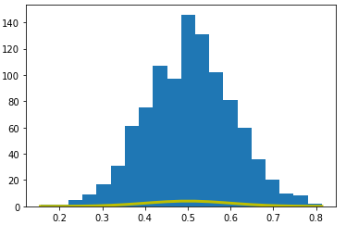
Normal Distribution - Output

Slide 5
Python – Binomial Distribution
The Binomial distribution model deals with the probability of success of an event which has only two possible outcomes in a series of experiments.
For ex , tossing a coin always gives a head or a tail.
The probability of finding exactly 3 heads in tossing a coin repeatedly for 10 times is estimated during the binomial distribution.

Slide 6
Python – Binomial Distribution
Seaborn library has in-built functions to create probability distribution graphs.
Scipy package helps in creating the binomial distribution.

Slide 7
Python – Binomial Distribution
from scipy.stats
import binom import seaborn as sb
binom.rvs(size=10,n=20,p=0.8)
data_binom = binom.rvs(n=20,p=0.8,loc=0,size=1000)
ax = sb.distplot(data_binom, kde=True, color='blue', hist_kws={"linewidth": 25,'alpha':1})
ax.set(xlabel='Binomial', ylabel='Frequency')

Slide 8
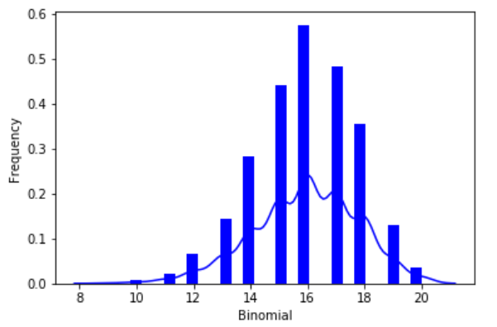
Binomial Distribution - Output

Slide 9
Python – Poisson Distribution
It is a distribution which shows the likely number of times that an event will occur within a pre – determined period of time.
It is used for independent events which occur at a constant rate within a given interval of time.
The poisson distribution is a discrete function , meaning that the event can only be measured as occuring or not occuring , meaning that the variable can only be measured in whole numbers.
Seaborn library has some in-built functions to create such probability distribution graphs.

Slide 10
Python – Poisson Distribution
from scipy.stats import poisson
import seaborn as sb
data_binom = poisson.rvs(mu=4, size=10000)
ax = sb.distplot(data_binom,
kde=True,
color='green',
hist_kws={"linewidth": 25,'alpha':1})
ax.set(xlabel='Poisson', ylabel='Frequency')

Slide 11
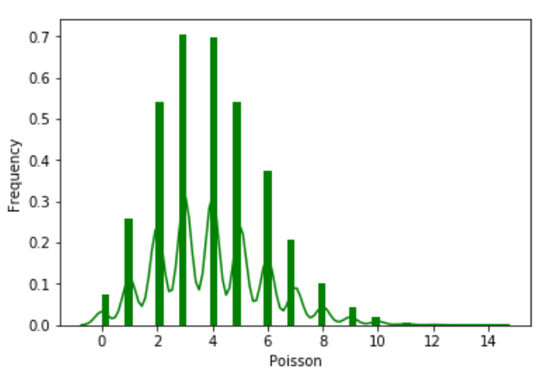
Poisson Distribution - Output

Slide 12
Python – Bernoulli Distribution
Bernoulli distribution is a special case of binomial distribution.
A single experiment is conducted where the number of observation is one.
Bernoulli distribution therefore describes events exactly having two outcomes.
Various functions in numpy library are used to mathematically calculate the values of Bernoulli distribution.

Slide 13
Python – Bernoulli Distribution
from scipy.stats import bernoulli
import seaborn as sb
data_bern = bernoulli.rvs(size=1000,p=0.6)
ax = sb.distplot(data_bern, kde=True, color='crimson', hist_kws={"linewidth": 25,'alpha':1})
ax.set(xlabel='Bernouli', ylabel='Frequency')

Slide 14
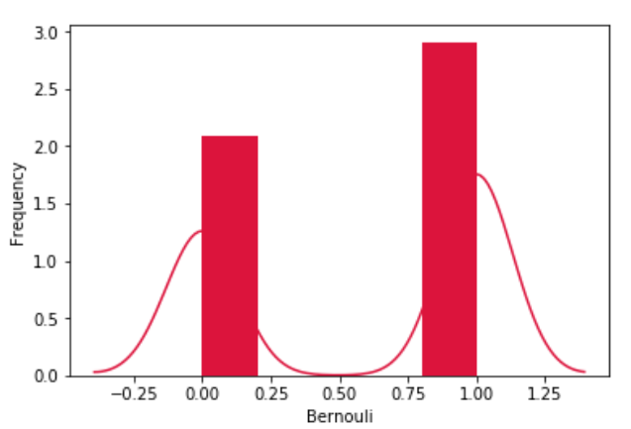
Bernoulli Distribution - Output

Slide 15
THANKS
Further Information:
Senthil Kumar – 98409 74406
Srinivasan – 7010888841
Kumarasamy - 8925533489
www.pantechelearning.com | training@pantechmail.com

